Slide 1
Blairtummock Housing Association
Performance analysis
January 2021
1

Slide 2
Key sector headlines for 2019-20
There are around 1,500 more homes compared to last year, an increase of around 0.4%.
Overall satisfaction remains similar to last year.
Stock meeting SHQS has increased, with failures falling.
The percentage of stock meeting EESSH is now 89%, but lower for LAs than RSLs
The average time to complete repairs remains the same. Tenancy sustainment for new tenants has fallen.
The number of evictions is down.
There was little sign of any impact from the COVID pandemic, with void rent loss and re-let times around the same, and a small increase in current arrears.
Homeless lets by RSLs has increased from 28% to 31%, still well below the LAs figure of 40%. Despite the increase in stock, the total number of lets was down slightly, reflecting a slightly lower tenancy turnover rate.
Sector headlines

Slide 3
Overall summary - 2019
Positives
Everything, especially:
EESSH (100% meeting in 2018/9)
0 evictions
low, low rent (£71.14)
very limited legal action, but still a good arrears record
Areas for concern?
23 offers refused
6 out of 35 lets to homeless

Slide 4
Peer Group
Ardenglen Housing Association
Blairtummock Housing Association
Calvay Housing Association
Cassiltoun Housing Association
Charing Cross Housing Association
Dalmuir Park Housing Association
Easthall Park Housing Cooperative
Ferguslie Park Housing Association
Lanarkshire Housing Association
Muirhouse Housing Association
Pineview Housing Association
Reidvale Housing Association
Rosehill Housing Co-operative
Wellhouse Housing Association

Slide 5
Tenant Satisfaction

Slide 6
Satisfaction survey Method
Tenants surveyed: 530
Date: January 2020
Method: ?

Slide 7
Large Scale Tenant Survey
Satisfaction Indicators (%) | 2019 | 2020
Overall Satisfaction | 97 | 92
Kept Informed | 99 | 97
Opportunities to Participate | 97 | 92
Quality of Home | 96 | 89
Repairs | 100 | 91
Management of Neighbourhood | 98 | 93
Value for Money | 91 | 92
Average | 97 | 92

Slide 8
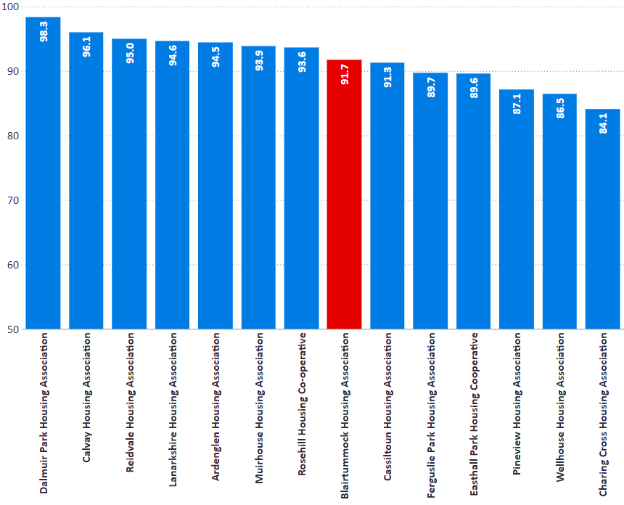
Overall Satisfaction
I1: Percentage of tenants satisfied with overall service.
% | 2017/18 | 2018/19 | 2019/20
Blairtummock HA | 97.0 | 97.0 | 91.7
Peer Group | 92.8 | 92.4 | 91.9
RSL Average | 91.7 | 90.9 | 90.5
National Average | 90.7 | 90.1 | 89.2

Slide 9
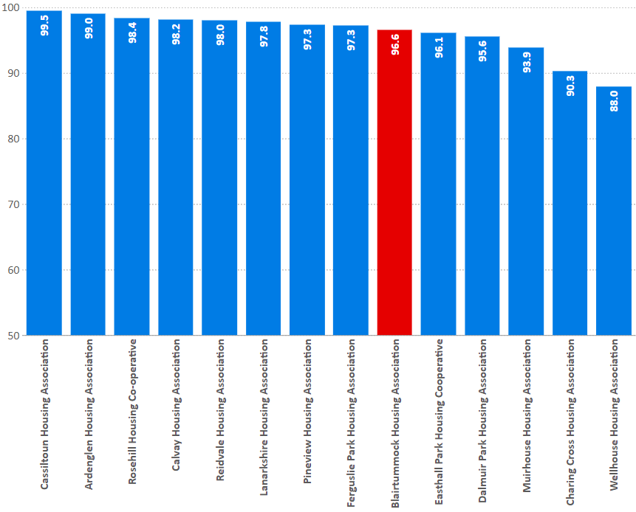
Kept Informed
I2: percentage of tenants who feel their landlord is good at keeping them informed about their services and outcomes
% | 2017/18 | 2018/19 | 2019/20
Blairtummock HA | 99.1 | 99.1 | 96.6
Peer Group | 95.3 | 96.0 | 96.1
RSL Average | 93.5 | 93.5 | 93.1
National Average | 92.2 | 91.6 | 92.0

Slide 10
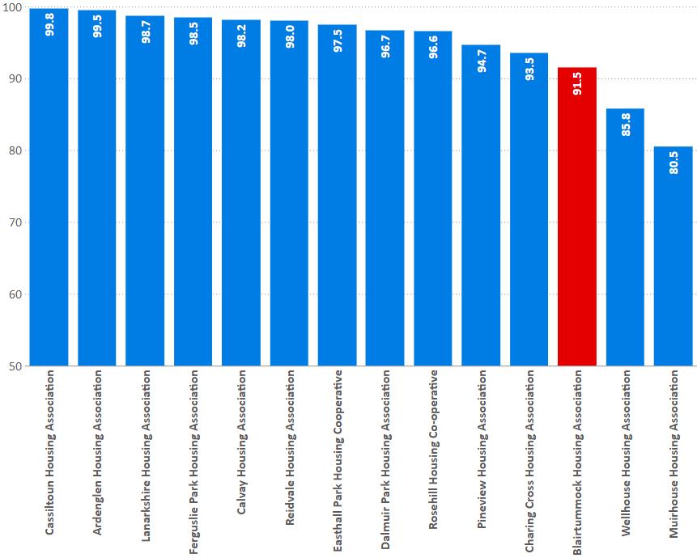
Opportunities to participate
I5: percentage of tenants satisfied with the opportunities given to them to participate in their landlord’s decision making processes
% | 2017/18 | 2018/19 | 2019/20
Blairtummock HA | 97.2 | 97.2 | 91.5
Peer Group | 90.8 | 92.5 | 95.2
RSL Average | 88.1 | 88.2 | 88.6
National Average | 86.4 | 86.5 | 87.2

Slide 11
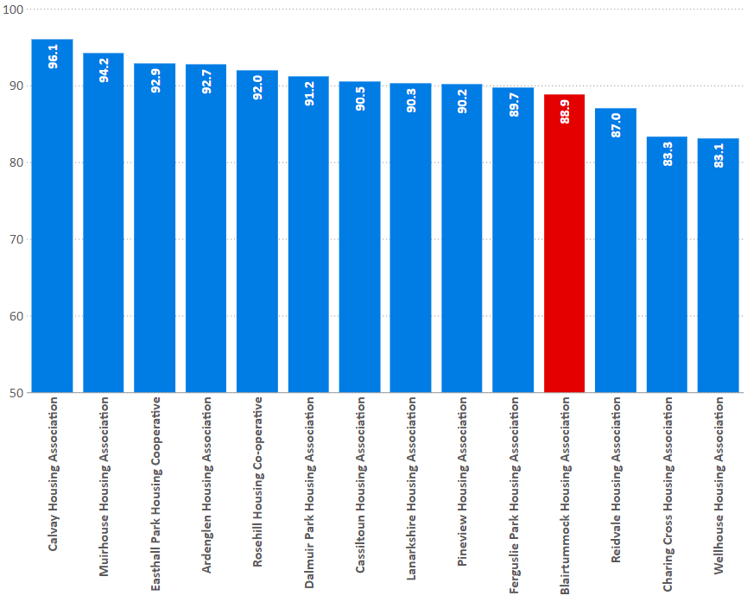
Quality of home (all tenants)
I7: percentage of existing tenants satisfied with the quality of their home.
% | 2017/18 | 2018/19 | 2019/20
Blairtummock HA | 96.4 | 96.4 | 88.9
Peer Group | 89.2 | 89.6 | 90.3
RSL Average | 89.1 | 88.7 | 88.4
National Average | 88.4 | 88.1 | 87.2

Slide 12
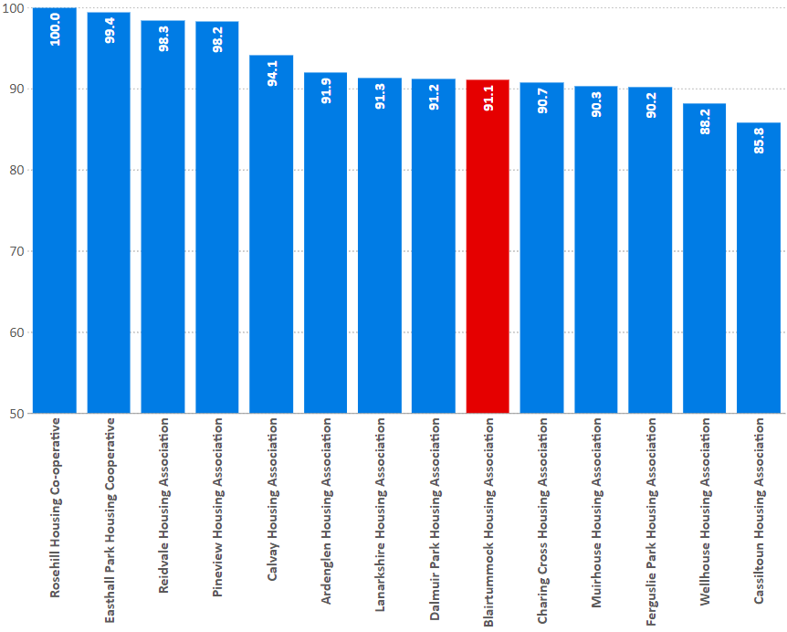
Repairs
I12: percentage of tenants who have had repairs or maintenance carried out in last 12 months satisfied with the repairs and maintenance service.
% | 2017/18 | 2018/19 | 2019/20
Blairtummock HA | 97.8 | 99.7 | 91.1
Peer Group | 94.6 | 95.0 | 93.1
RSL Average | 92.3 | 92.5 | 91.0
National Average | 92.1 | 91.7 | 90.8

Slide 13
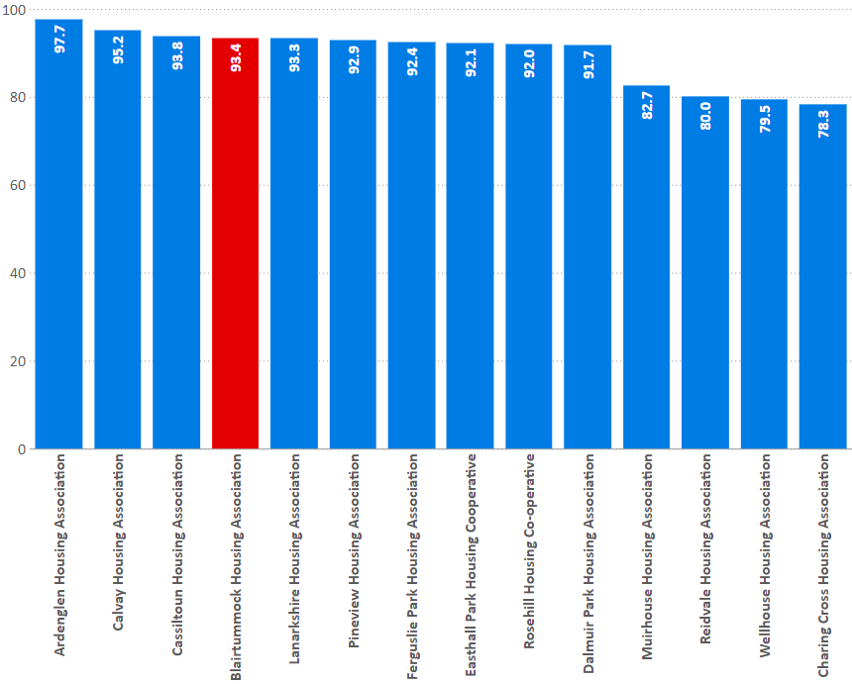
Management of neighbourhood
I13: Percentage of tenants satisfied with the landlord’s contribution to the management of the neighbourhood they live in
% | 2017/18 | 2018/19 | 2019/20
Blairtummock HA | 97.7 | 97.7 | 93.4
Peer Group | 90.4 | 90.6 | 89.4
RSL Average | 89.3 | 88.4 | 87.8
National Average | 88.5 | 87.8 | 87.4

Slide 14
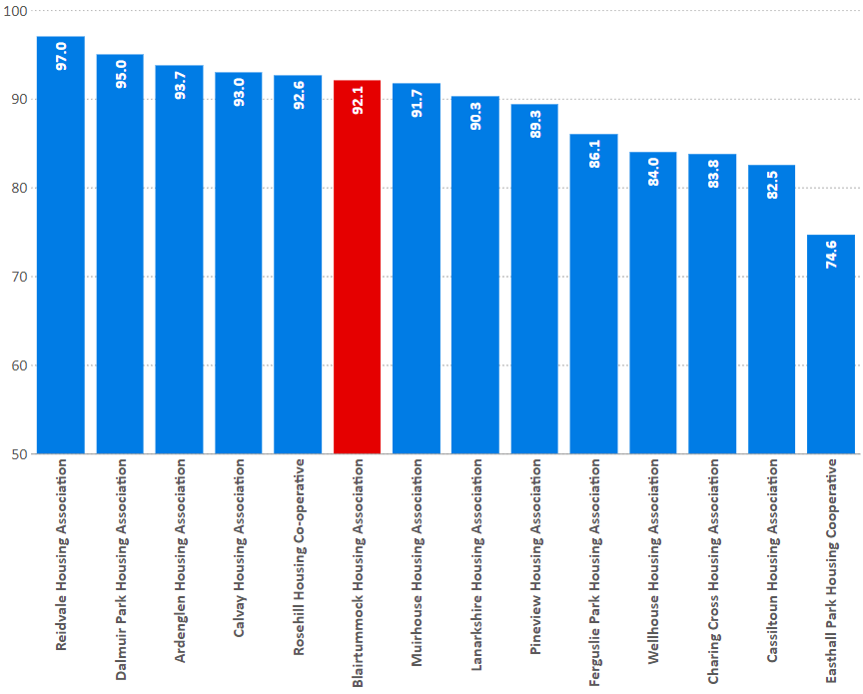
Value for money
I25: percentage of tenants who feel that the rent for their property represents good value for money.
% | 2017/18 | 2018/19 | 2019/20
Blairtummock HA | 91.3 | 91.3 | 92.1
Peer Group | 83.6 | 86.3 | 88.8
RSL Average | 83.9 | 83.4 | 83.5
National Average | 83.4 | 83.2 | 83.6

Slide 15
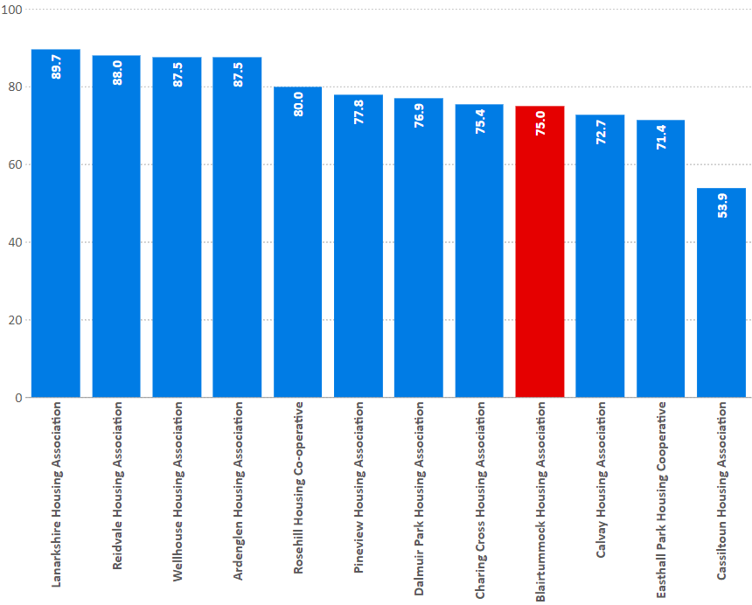
Factoring
I29: Percentage of tenants satisfied with the factoring service.
% | 2017/18 | 2018/19 | 2019/20
Blairtummock HA | 75.0 | 75.0 | 75.0
Peer Group | 80.0 | 79.6 | 78.3
RSL Average | 65.9 |  | 68.2
National Average | 63.4 | 67.0 | 66.8

Slide 16
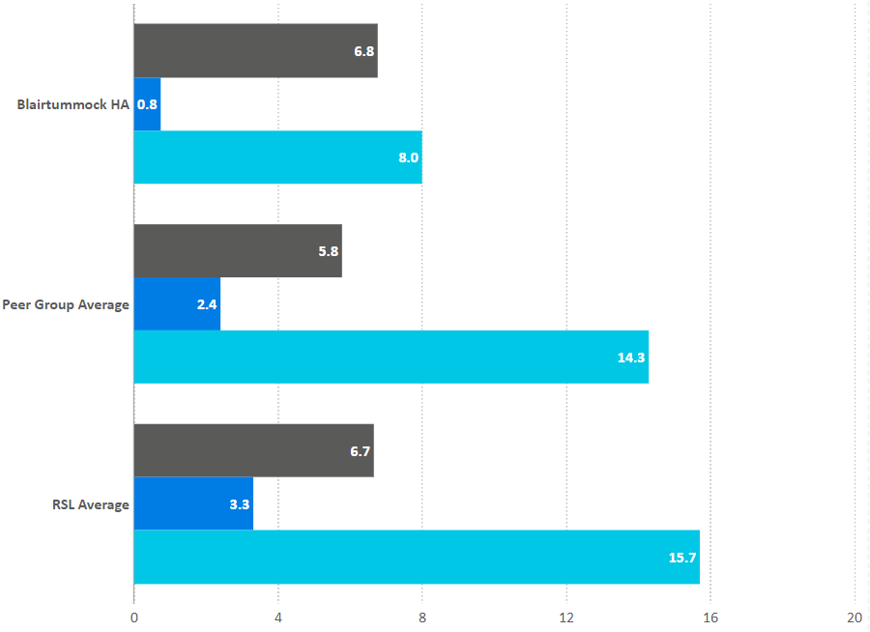
Complaints
I3: Complaints per 100 homes
I4: Time to respond to 1st & 2nd stage complaints
 | BHA | Peer Group | RSL Average
Per 100 homes | 6.8 | 5.8 | 6.7
1st stage – days to respond | 0.8 | 2.4 | 3.3
2nd stage – days to respond | 8.0 | 14.3 | 15.7

Slide 17
Housing Quality & Maintenance

Slide 18
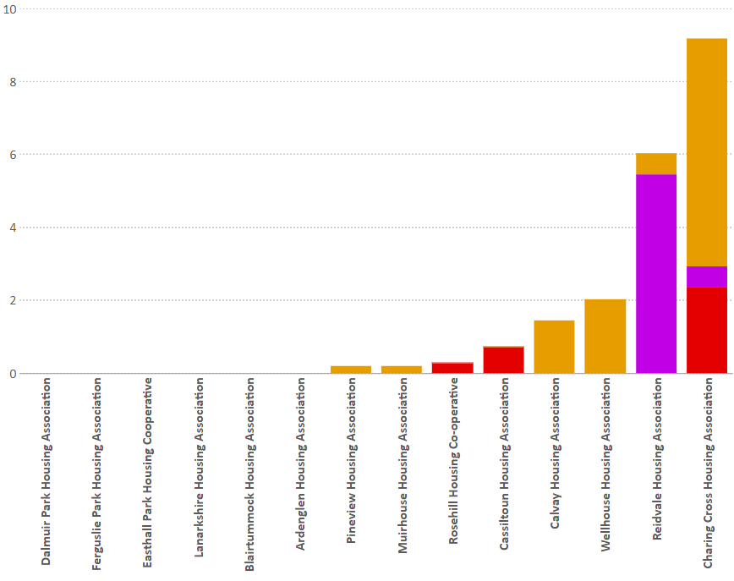
SHQS
Indicator 6: Percentage of stock meeting the Scottish Housing Quality Standard
Blairtummock HA | 2017/18 | 2018/19 | 2019/20
Meeting SHQS | 100.0 | 100.0 | 100.0
Exempt | 0.0 | 0.0 | 0.0
Abeyances | 0.0 | 0.0 | 0.0
Failing | 0.0 | 0.0 | 0.0
% | 2017/18 | 2018/19 | 2019/20
Blairtummock HA | 100.0 | 100.0 | 100.0
Peer Group | 97.2 | 97.8 | 98.5
RSL Average | 93.9 | 93.0 | 92.9
National Average | 94.2 | 93.7 | 94.4

Slide 19
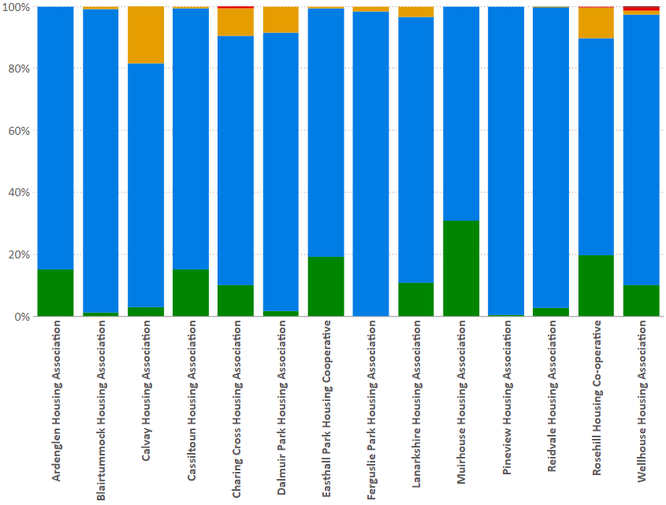
EESSH
Meeting EESSH: 92.3%
EPC: Percentage of stock with a valid EPC certificate within each band
C12: EPC is ‘C’ or better
% | A | B | C | D | E | F | G
Blairtummock HA | 0.0 | 1.1 | 97.9 | 1.0 | 0.0 | 0.0 | 0.0
% | 2019/20
Blairtummock HA | 99.0
Peer Group | 95.7
RSL Average | 82.8
National Average | 73.0

Slide 20
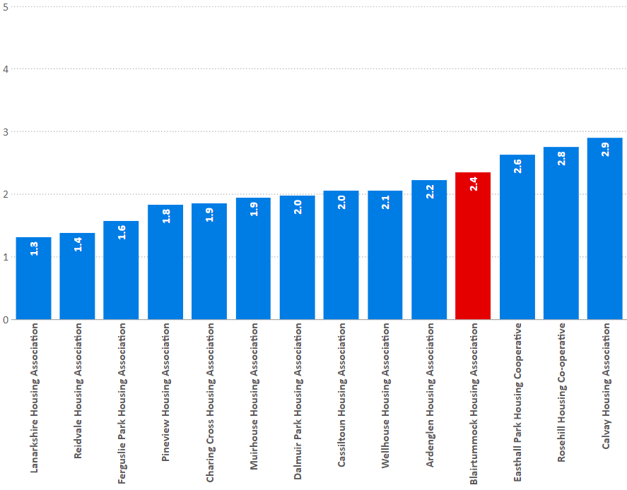
Emergency repairs
I8: Average length of time taken to complete emergency repairs (hours)
Hours | 2017/18 | 2018/19 | 2019/20
Blairtummock HA | 2.3 | 2.0 | 2.4
Peer Group | 2.1 | 2.0 | 2.0
RSL Average | 2.9 | 2.7 | 2.6
National Average | 4.0 | 3.7 | 3.6

Slide 21
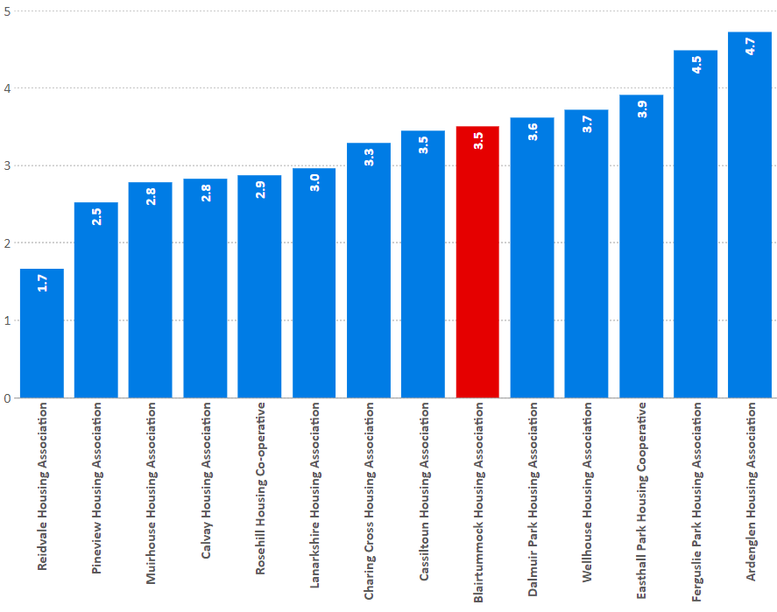
Non-emergency repairs
I9: Average length of time taken to complete non-emergency repairs (working days)
days | 2017/18 | 2018/19 | 2019/20
Blairtummock HA | 3.5 | 3.5 | 3.5
Peer Group | 3.4 | 3.5 | 3.3
RSL Average | 5.2 | 5.5 | 5.7
National Average | 6.4 | 6.6 | 6.4

Slide 22
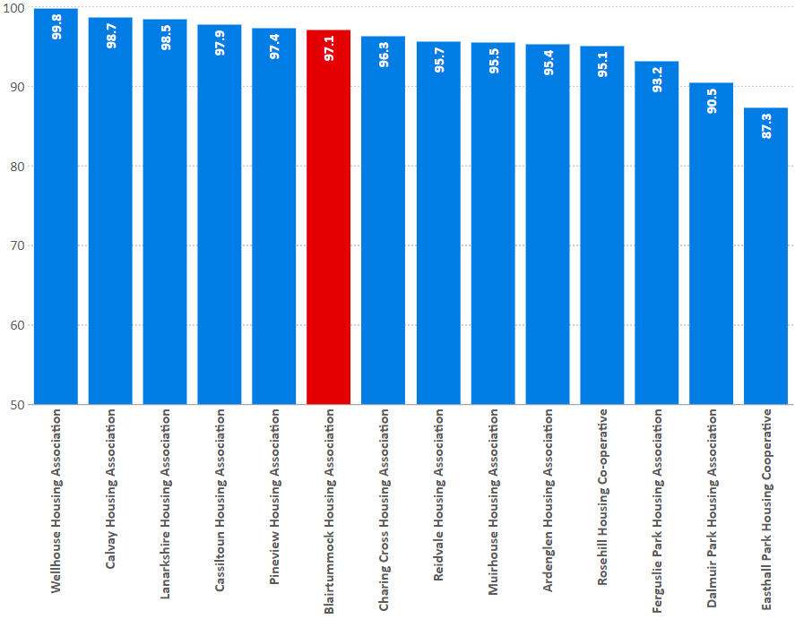
Repairs Right First Time
I10: Percentage of reactive repairs carried out in the last year completed right first time
% | 2017/18 | 2018/19 | 2019/20
Blairtummock HA | 96.7 | 96.9 | 97.1
Peer Group | 94.9 | 94.0 | 95.5
RSL Average | 91.5 | 92.3 | 92.4
National Average | 92.2 | 92.5 | 92.4

Slide 23
Repairs satisfaction
I12: percentage of tenants who have had repairs or maintenance carried out in last 12 months satisfied with the repairs and maintenance service.
% | 2017/18 | 2018/19 | 2019/20
Blairtummock HA | 97.8 | 99.7 | 91.1
Peer Group | 94.6 | 95.0 | 93.1
RSL Average | 92.3 | 92.5 | 91.0
National Average | 92.1 | 91.7 | 90.8

Slide 24
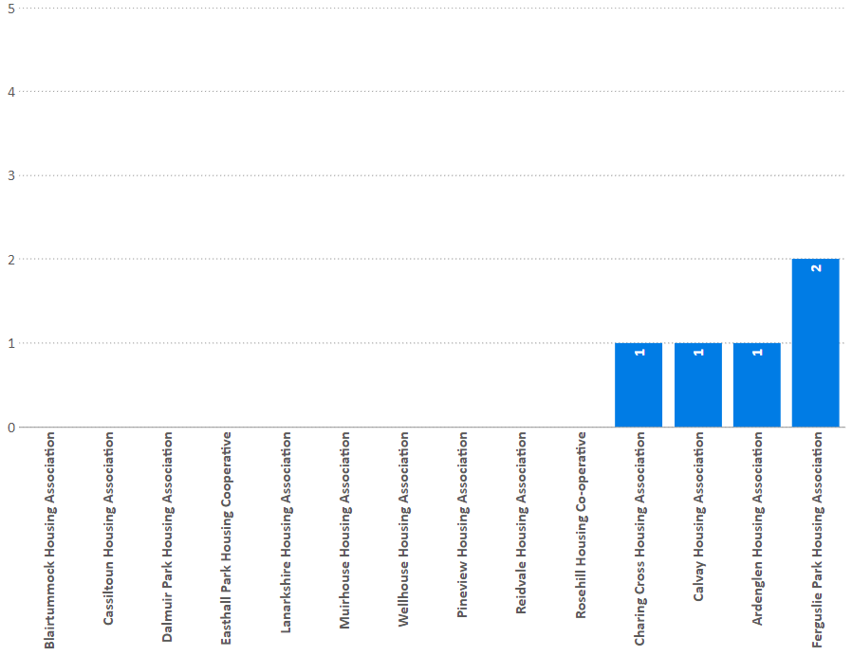
Gas safety
I11: Number of properties that failed to have a gas safety check and record completed by the anniversary date.
Totals | 2019/20
Blairtummock HA | 0
Peer Group | 5
RSL Total | 208
National Total | 496

Slide 25
Access

Slide 26
Access
Housing lists & lets
General needs lets | 27
Supported housing lets | 0
Number of lets to existing tenants; | 7
Number of lets to housing list applicants; | 15
Number of mutual exchanges | 3
Number of lets from other sources. | 0
Number of applicants assessed as statutorily homeless | 5

Slide 27
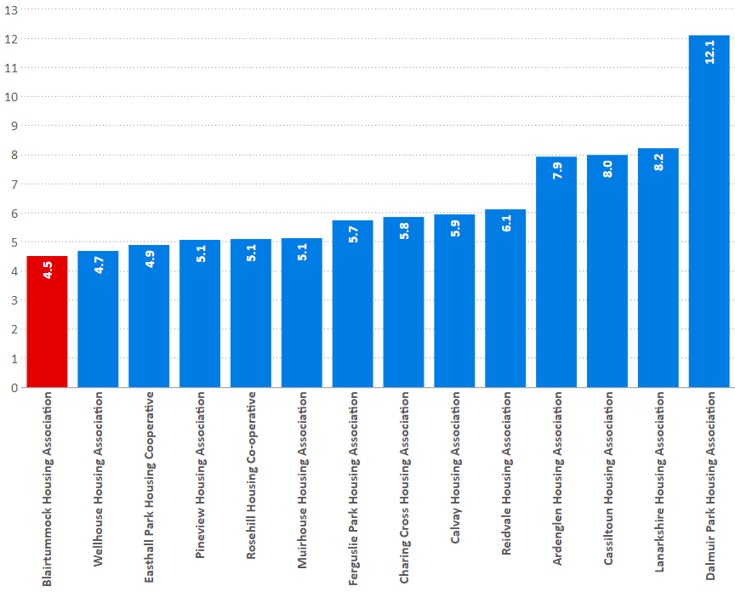
Turnover
I17: Percentage of lettable houses that became vacant in the last year.
% | 2017/18 | 2018/19 | 2019/20
Blairtummock HA | 3.9 | 4.7 | 4.5
Peer Group | 7.1 | 6.5 | 6.5
RSL Average | 8.8 | 8.7 | 8.8
National Average | 8.6 | 8.6 | 8.4

Slide 28
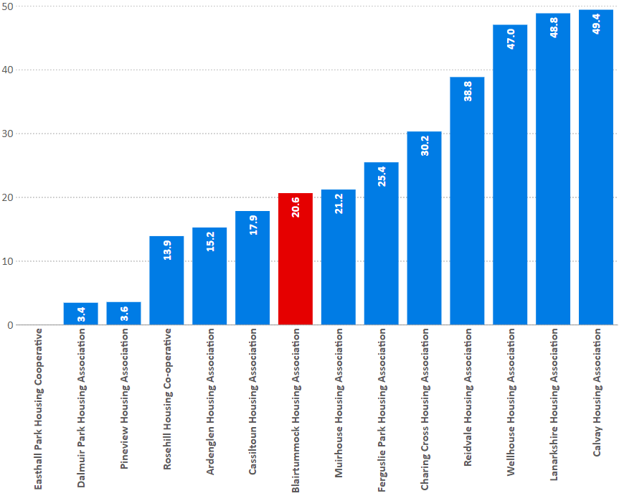
Offers refused
I14: Percentage of tenancy offers refused during the year.
% | 2017/18 | 2018/19 | 2019/20
Blairtummock HA | 35.9 | 39.0 | 20.6
Peer Group | 21.7 | 23.9 | 24.2
RSL Average | 30.8 | 31.1 | 29.5
National Average | 35.9 | 36.3 | 34.2

Slide 29
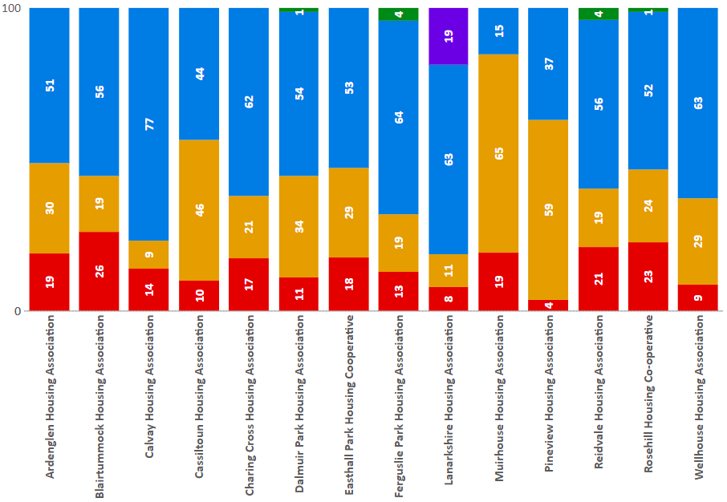
Lets by source
C2: The percentage of lets during the reporting year by source of let.
% | BHA | Peer Group | RSL Average
Existing tenants | 26 | 14 | 14
Homeless applicants | 19 | 31 | 26
Housing list applicants | 56 | 53 | 51
LA Nominations | 0 | 2 | 5
Others | 0 | 1 | 4

Slide 30
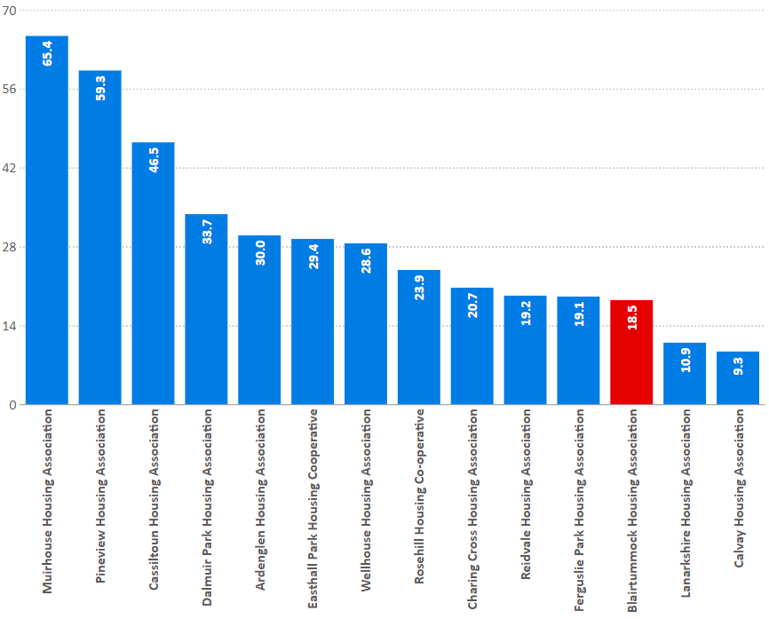
Lets to homeless
C2: The percentage of lets during the reporting year to tenants that have been assessed as statutorily homeless.
% | 2017/18 | 2018/19 | 2019/20
Blairtummock HA | 6.9 | 17.1 | 18.5
Peer Group | 21.5 | 23.3 | 30.5
RSL Average | 22.7 | 23.7 | 25.6
National Average | 32.9 | 33.2 | 34.5

Slide 31
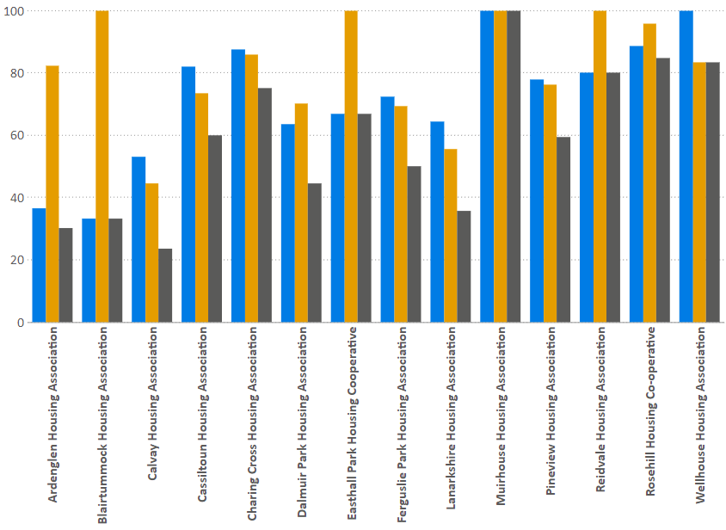
Homeless referrals
Blairtummock HA
Referrals 15
Offers 5
Accepted 5

Slide 32
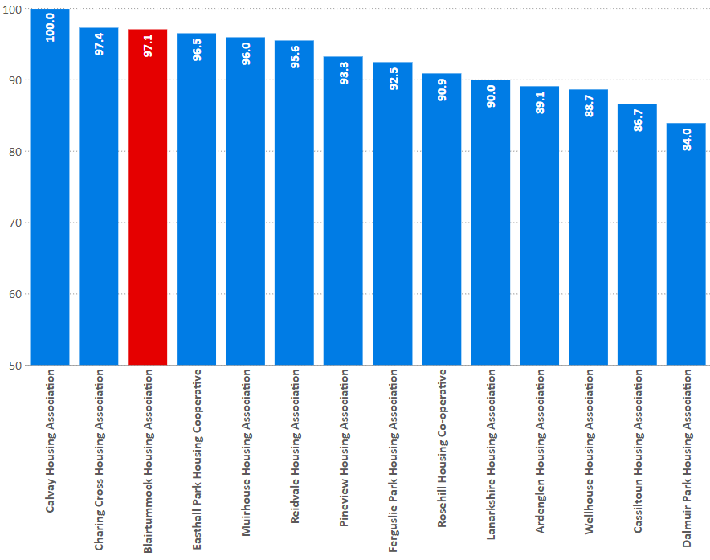
Tenancy sustainment
I16: Percentage of new tenancies sustained for more than a year; all sources of let.
% | 2017/18 | 2018/19 | 2019/20
Blairtummock HA | 93.0 | 93.1 | 97.1
Peer Group | 90.8 | 94.4 | 92.4
RSL Average | 88.2 | 88.5 | 88.9
National Average | 88.7 | 88.8 | 89.1

Slide 33
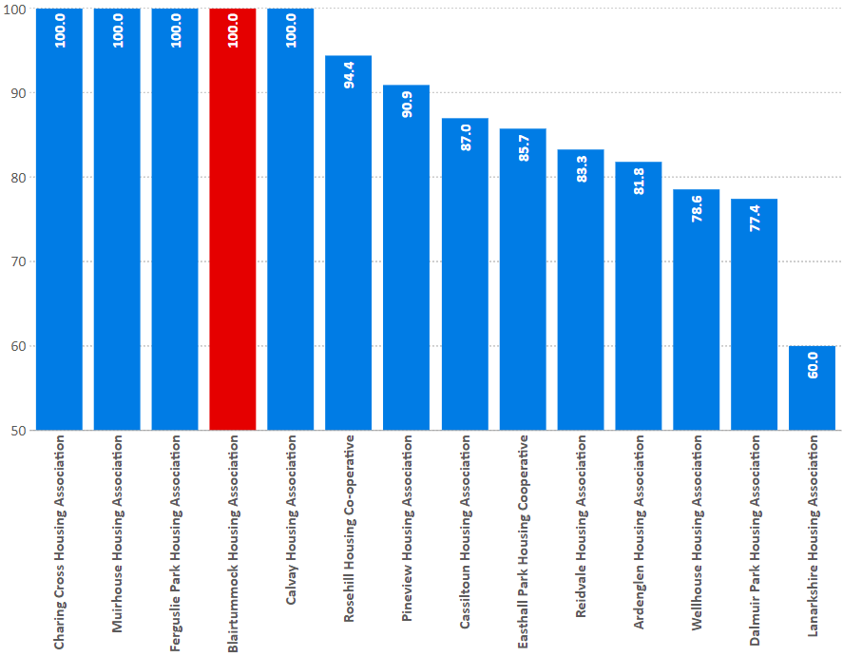
Tenancy sustainment (homeless)
I16: Percentage of new tenancies sustained for more than a year; statutory homeless.
% | 2017/18 | 2018/19 | 2019/20
Blairtummock HA | 80.0 | 100.0 | 100.0
Peer Group | 87.2 | 91.8 | 87.6
RSL Average | 89.7 | 89.3 | 89.2
National Average | 88.2 | 87.9 | 88.1

Slide 34
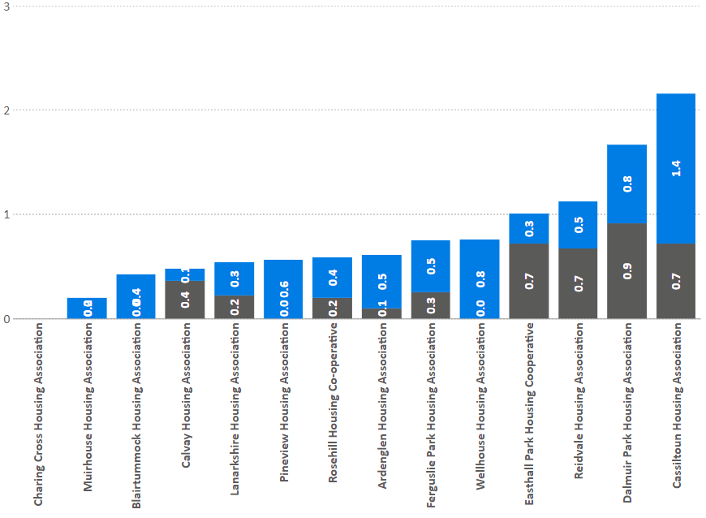
Evictions
I22: Evictions
Evictions as a percentage of stock
% | 2017/18 | 2018/19 | 2019/20
Blairtummock HA | 0.43 | 0.00 | 0.00
Peer Group | 0.17 | 0.30 | 0.32
RSL Average | 0.32 | 0.33 | 0.27
National Average | 0.38 | 0.39 | 0.31
C4: Abandonments as a percentage of stock.
% | 2017/18 | 2018/19 | 2019/20
Blairtummock HA | 0.43 | 0.28 | 0.42
Peer Group | 0.53 | 0.44 | 0.48
RSL Average | 0.52 | 0.56 | 0.54
National Average | 0.56 | 0.60 | 0.57

Slide 35
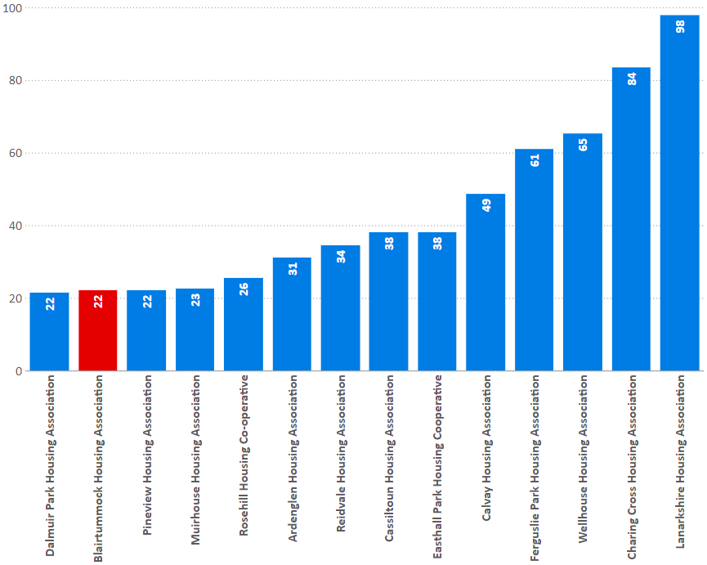
Medical adaptations
I21: The average number of days to complete medical adaptations during the reporting year.
Calendar Days | 2017/18 | 2018/19 | 2019/20
Blairtummock HA | 2 | 46 | 22
Peer Group | 74 | 78 | 45
RSL Average | 62 | 58 | 50
National Average | 48 | 49 | 42

Slide 36
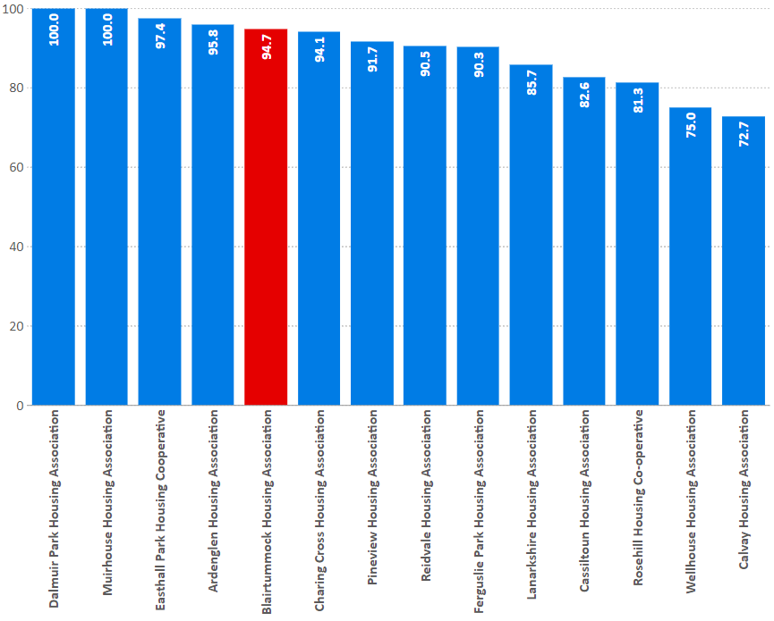
Medical adaptations
I19: Percentage of approved applications completed in year
% | 2017/18 | 2018/19 | 2019/20
Blairtummock HA | 100.0 | 100.0 | 94.7
Peer Group | 78.7 | 82.0 | 89.0
RSL Average | 81.1 | 83.7 | 82.2
National Average | 84.3 | 84.7 | 83.8

Slide 37
Rents

Slide 38
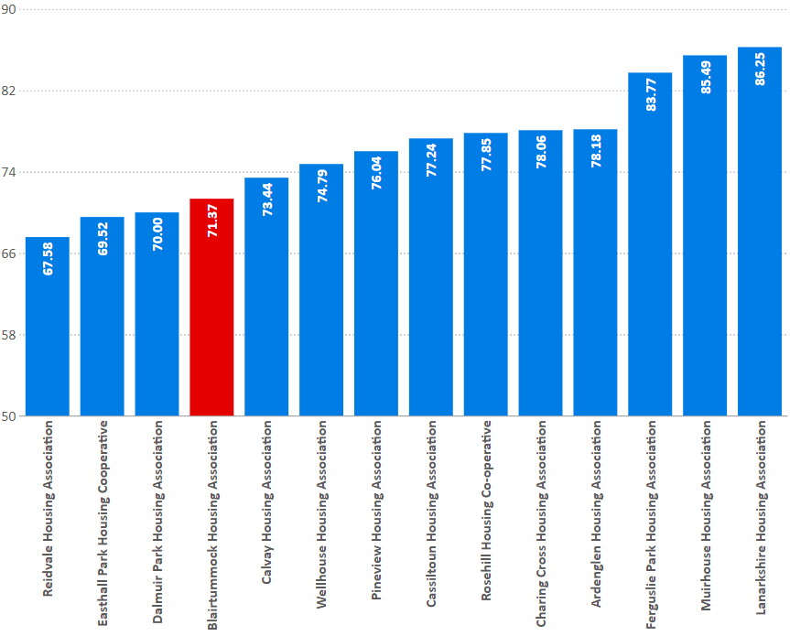
Average rent
C17: Average weekly rent (£)
- 3 Apt
 | 2017/18 | 2018/19 | 2019/20
Blairtummock HA | 67.17 | 69.58 | 71.37
Peer Group | 73.06 | 75.48 | 76.79
RSL Average | 80.63 | 83.45 | 86.22
National Average | 74.94 | 77.70 | 80.11

Slide 39
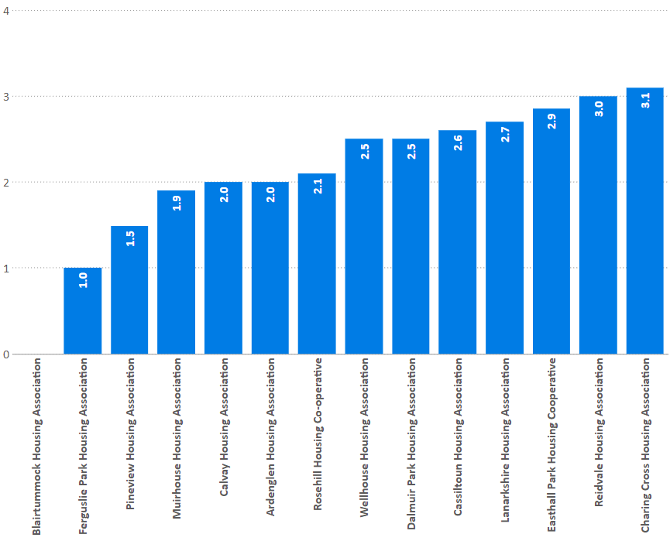
Rent increase
C5: Average percentage change in weekly rent
% | 2017/18 | 2018/19 | 2019/20
Blairtummock HA | 3.0 | 2.5 | 0.0
Peer Group | 3.2 | 3.0 | 2.3
RSL Average | 3.2 | 3.0 | 2.4
National Average | 3.2 | 3.0 | 2.5

Slide 40
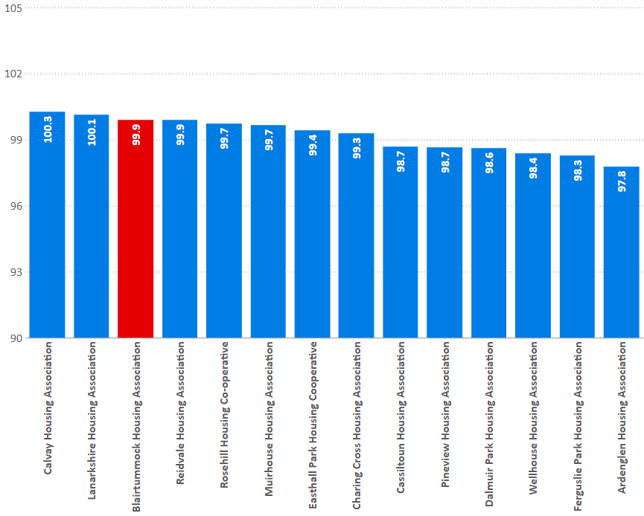
Rent collection
I26: Rent collected from tenants as a percentage of total rent due in the reporting year
% | 2017/18 | 2018/19 | 2019/20
Blairtummock HA | 100.5 | 99.0 | 99.9
Peer Group | 99.4 | 99.0 | 99.1
RSL Average | 99.6 | 99.6 | 99.5
National Average | 99.4 | 99.1 | 99.3

Slide 41
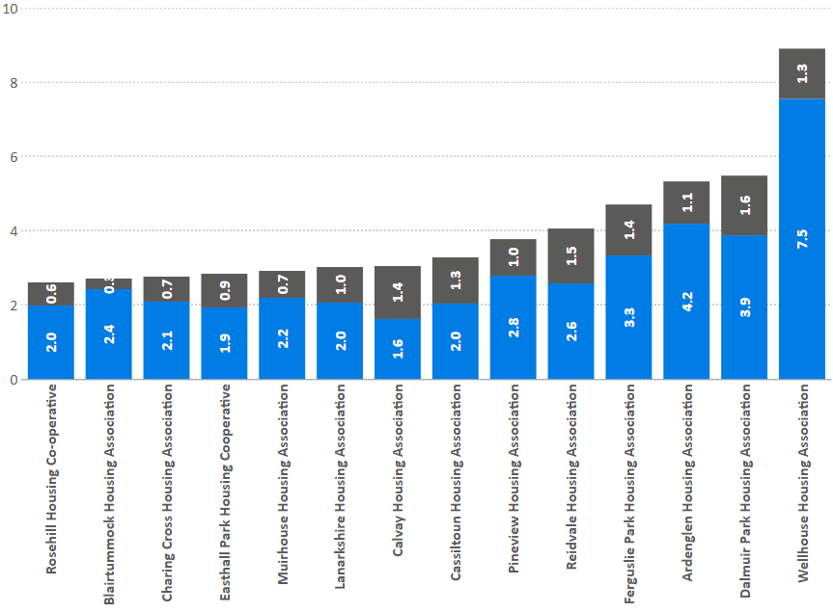
Arrears
I27: Current rent arrears (all tenants) as at 31 March each year as a percentage of rent due for the reporting year.
% | 2017/18 | 2018/19 | 2019/20
Blairtummock HA | 2.8 | 2.2 | 2.4
Peer Group | 2.4 | 2.7 | 2.9
RSL Average | 3.0 | 2.8 | 3.0
National Average | 3.4 | 3.6 | 3.8

Slide 42
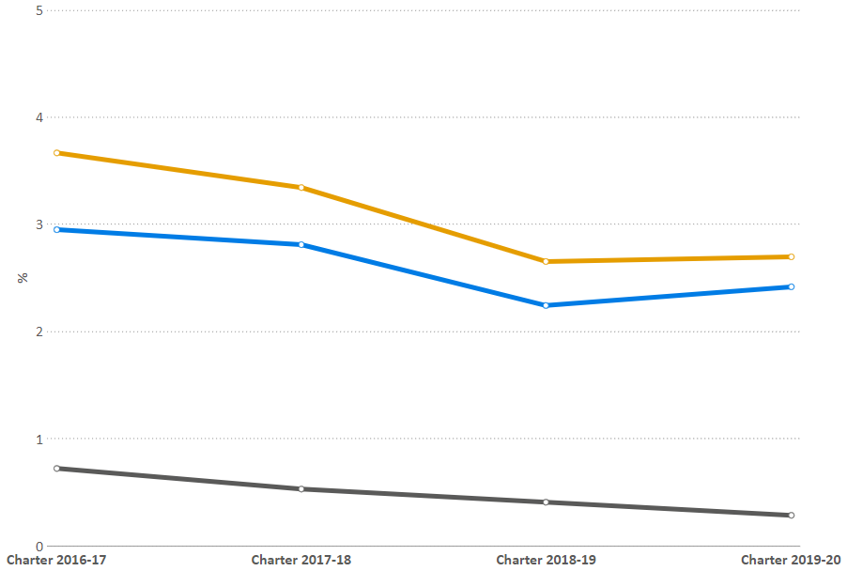
Arrears (trends)
I27: Gross Arrears trends
% | 2017/18 | 2018/19 | 2019/20
Blairtummock HA | 3.3 | 2.7 | 2.7
Peer Group | 3.6 | 3.7 | 4.1
RSL Average | 4.3 | 4.2 | 4.4
National Average | 5.4 | 5.7 | 5.8

Slide 43
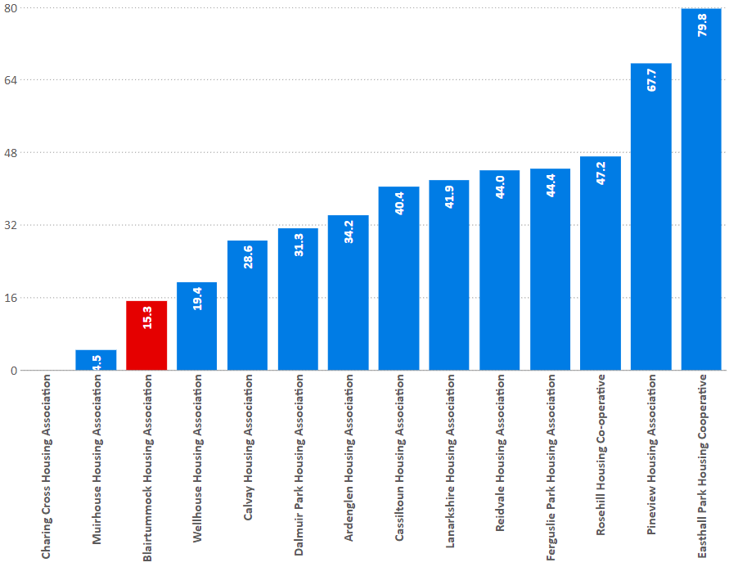
Arrears written off
C7: percentage of former tenant rent arrears written off at the year end.
% | 2017/18 | 2018/19 | 2019/20
Blairtummock HA | 43.1 | 53.7 | 15.3
Peer Group | 43.7 | 42.4 | 37.2
RSL Average | 46.8 | 45.1 | 41.2
National Average | 36.1 | 37.9 | 34.4

Slide 44
Voids

Slide 45
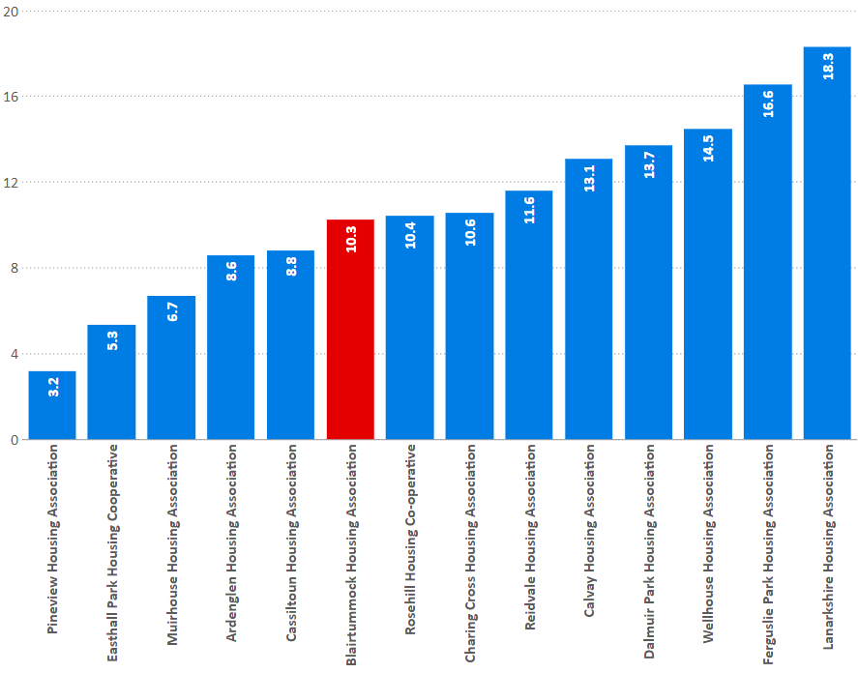
Relet times
I30: Average length of time taken to relet properties in the last year (calendar days)
% | 2017/18 | 2018/19 | 2019/20
Blairtummock HA | 14.1 | 11.6 | 10.3
Peer Group | 11.0 | 11.1 | 10.9
RSL Average | 29.0 | 29.5 | 27.2
National Average | 30.7 | 31.9 | 31.8

Slide 46
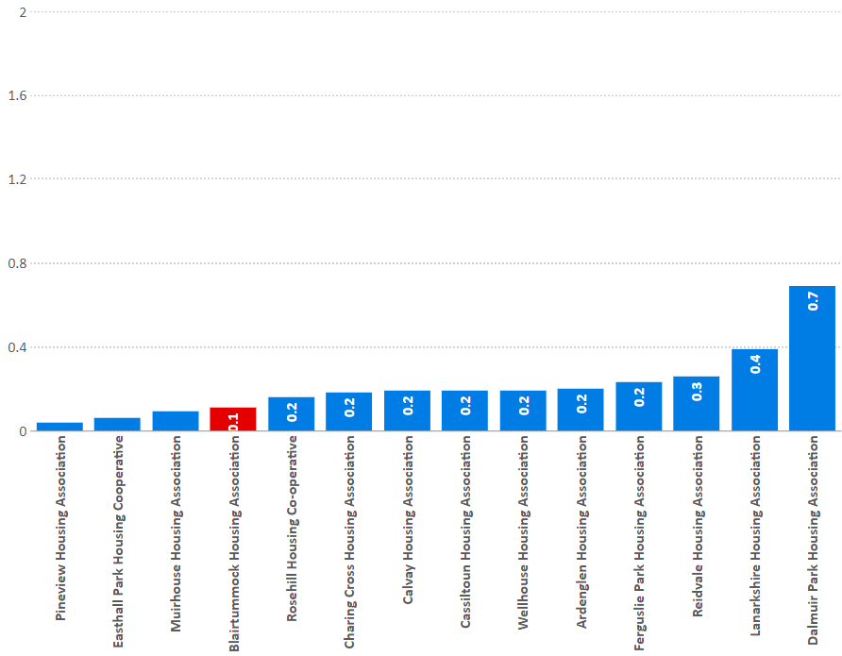
Void rent loss
I18: percentage of rent lost through properties being empty in the last year
% | 2017/18 | 2018/19 | 2019/20
Blairtummock HA | 0.1 | 0.1 | 0.1
Peer Group | 0.2 | 0.2 | 0.2
RSL Average | 0.9 | 0.9 | 0.9
National Average | 0.9 | 0.9 | 0.9

Slide 47
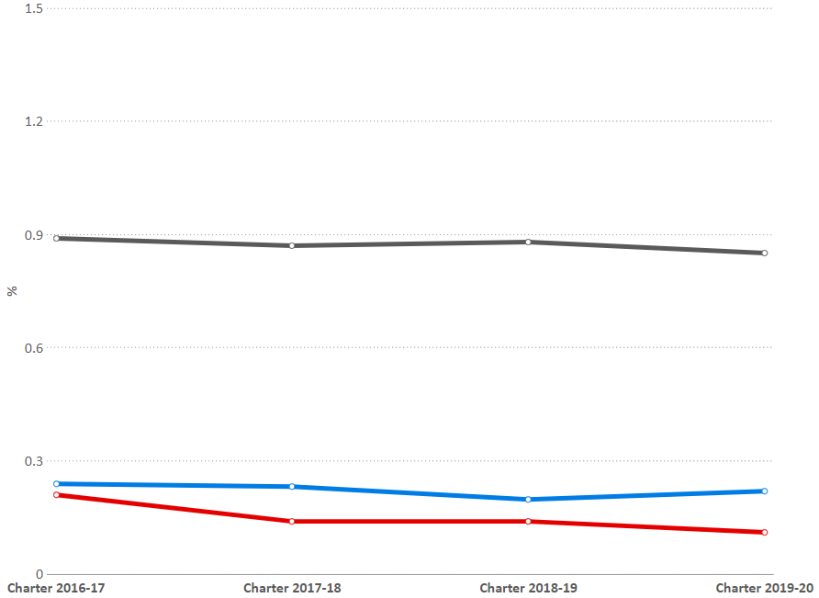
Void rent loss (trends)
I18: percentage of rent lost through properties being empty in the last year
% | 2017/18 | 2018/19 | 2019/20
Blairtummock HA | 0.1 | 0.1 | 0.1
Peer Group | 0.2 | 0.2 | 0.2
RSL Average | 0.9 | 0.9 | 0.9
National Average | 0.9 | 0.9 | 0.9

Slide 48
Landlord Report
Service
Satisfaction:
Overall
Keeping informed
Opportunities to participate
SHQS
Emergency repairs time
Non-emergency repairs time
Right first time
Repairs satisfaction
Value for Money
Annual rent increase
Void relet time
Void rent loss
Rent collected
Service and Value for Money
Landlord Report Indicators

Slide 49
Landlord Report
-
-
-
 | Overall satisfaction | Informed | Involved | SHQS | Emergency repairs | Non-emergency repairs | Right first time | Repairs satisfaction | Anti-social behaviour | Rent increase | Average rent 3-apt | Average rent - all | Rent collected | Void rent loss | Re-let time
Ardenglen Housing Association | 94.47 | 98.99 | 99.5 | 100 | 2.22 | 4.72 | 95.36 | 91.94 | 93.33 | 2 | 78.18 | 77.88 | 97.77 | 0.20 | 8.6
Blairtummock Housing Association | 91.7 | 96.6 | 91.51 | 100 | 2.35 | 3.50 | 97.09 | 91.07 | 100 | 0 | 71.37 | 73.38 | 99.89 | 0.11 | 10.26
Calvay Housing Association | 96.06 | 98.18 | 98.18 | 98.55 | 2.9 | 2.83 | 98.68 | 94.08 | 98.48 | 2 | 73.44 | 74.71 | 100.27 | 0.19 | 13.09
Cassiltoun Housing Association | 91.25 | 99.5 | 99.75 | 99.28 | 2.05 | 3.45 | 97.86 | 85.77 | 100 | 2.6 | 77.24 | 81.45 | 98.67 | 0.19 | 8.8
Charing Cross Housing Association | 84.09 | 90.26 | 93.51 | 90.82 | 1.85 | 3.29 | 96.3 | 90.74 | 86.67 | 3.1 | 78.06 | 76.81 | 99.29 | 0.18 | 10.55
Easthall Park Housing Cooperative | 89.64 | 96.07 | 97.5 | 100 | 2.63 | 3.91 | 87.31 | 99.38 | 100 | 2.85 | 69.52 | 73.52 | 99.43 | 0.06 | 5.35
Ferguslie Park Housing Association | 89.7 | 97.27 | 98.48 | 100 | 1.6 | 4.5 | 93.2 | 90.21 | 96.83 | 1 | 83.77 | 85.68 | 98.27 | 0.23 | 16.56
Muirhouse Housing Association | 93.86 | 93.86 | 80.51 | 99.8 | 1.94 | 2.78 | 95.53 | 90.32 | 100 | 1.9 | 85.49 | 87.33 | 99.67 | 0.09 | 6.69
Pineview Housing Association | 97.33 | 97.33 | 94.67 | 99.81 | 1.83 | 2.52 | 97.37 | 98.21 | 97.1 | 1.49 | 76.04 | 78.25 | 98.65 | 0.04 | 3.19
Wellhouse Housing Association | 86.45 | 87.95 | 85.84 | 97.98 | 2.06 | 3.72 | 99.81 | 88.18 | 94.2 | 2.5 | 74.79 | 77.95 | 98.37 | 0.19 | 14.46

Slide 50
Landlord Report
Service v Value for money
Comparison with Peer group

Slide 51
Overall summary - 2019
Positives
Everything, especially:
EESSH (100% meeting in 2018/9)
0 evictions
low, low rent (£71.14)
very limited legal action, but still a good arrears record
Areas for concern?
23 offers refused
6 out of 35 lets to homeless

Slide 52
Overall summary - 2020
Positives
Lots of things, including:
SHQS and EESSH (100% meeting)
100% gas safety checks completed
Tenancy sustainment, especially homeless lets (100%)
0 evictions, again
0% rent rise
Former Rent Arrears – only 0.3% of rent owed
Areas for concern?
Satisfaction trends – is this significant?
EESSH2 – a substantial commitment
5 lets to homeless, 10 homeless referrals not made offer (issues with GCC referrals?)

Slide 53
Scotland’s Housing Network
First floor, 19 Haymarket Yards
Edinburgh
EH12 5BH
T: 0131 466 3710
E: info@scotlandshousingnetwork.org
W: www.scotlandshousingnetwork.org
@ScotHousingNet
facebook.com/scotlandshousingnetwork
Linkedin.com – Scotland’s Housing Network

