Slide 1
Cover
November 2023
Notes:
Performance Analysis Visit 2022/23
No alt text provided
October 2023
No alt text provided
card
No alt text provided
shape
No alt text provided
image
No alt text provided
image
No alt text provided
shape
No alt text provided
image
No alt text provided

Slide 2
National Overview
Notes:
National Overview 2022/23
No alt text provided
shape
No alt text provided
shape
No alt text provided
shape
No alt text provided
shape
No alt text provided
shape
No alt text provided
Tenants Surveyed:
No alt text provided
shape
No alt text provided
image
No alt text provided
image
No alt text provided

Slide 3
National Overview
Notes:
National Overview 2022/23
No alt text provided
shape
No alt text provided
shape
No alt text provided
shape
No alt text provided
shape
No alt text provided
shape
No alt text provided
Tenants Surveyed:
No alt text provided
shape
No alt text provided
shape
No alt text provided
shape
No alt text provided
image
No alt text provided
image
No alt text provided

Slide 4
Comparator Organisations
Notes:
Peer Group
No alt text provided
tableEx
No alt text provided
shape
No alt text provided
image
No alt text provided
image
No alt text provided

Slide 5
Cover 2
Notes:
Tenant Satisfaction
No alt text provided
image
No alt text provided
shape
No alt text provided
image
No alt text provided

Slide 6
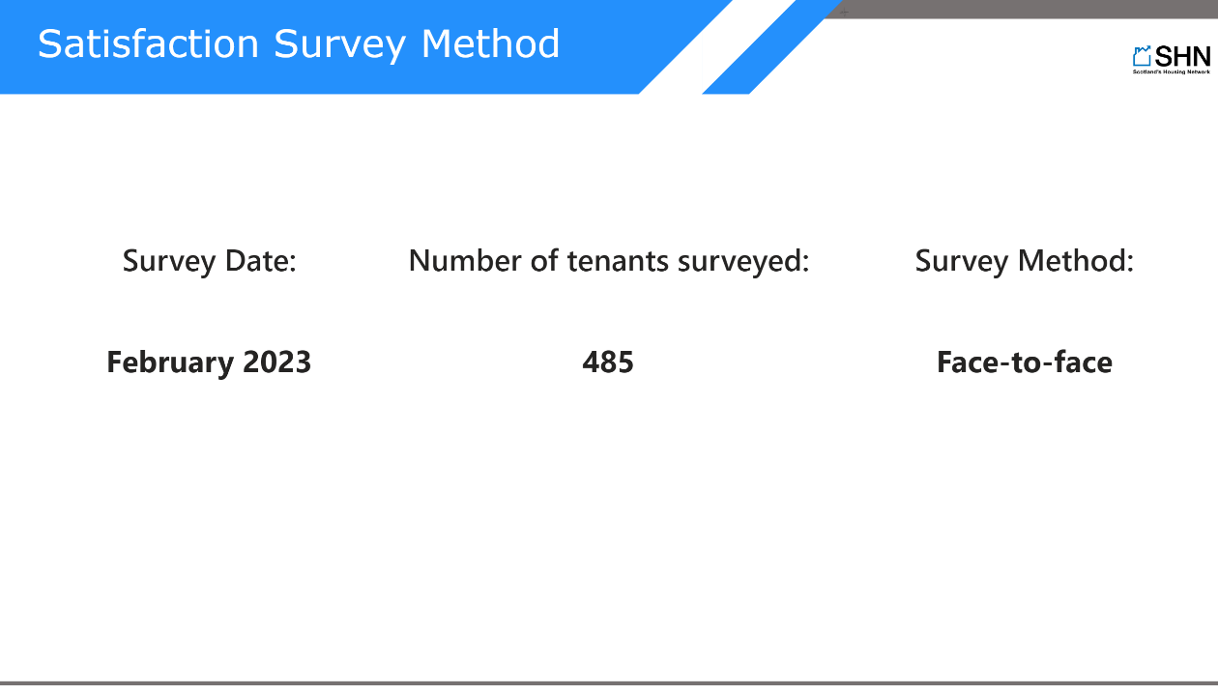
Survey Method
Notes:
Satisfaction Survey Method
No alt text provided
Survey Date:
No alt text provided
Number of tenants surveyed:
No alt text provided
Survey Method:
No alt text provided
shape
No alt text provided
image
No alt text provided
image
No alt text provided

Slide 7
I1
Notes:
Overall Satisfaction
No alt text provided
clusteredColumnChart
No alt text provided
pivotTable
No alt text provided
I1 Percentage satisfied with overall service
No alt text provided
shape
No alt text provided
image
No alt text provided
image
No alt text provided
lineChart
No alt text provided

Slide 8
I1
Notes:
Overall Satisfaction
No alt text provided
I1 Percentage satisfied with overall service
No alt text provided
Change from previous survey
No alt text provided
shape
No alt text provided
image
No alt text provided
image
No alt text provided
image
No alt text provided
shape
No alt text provided

Slide 9
I2
Notes:
Kept Informed
No alt text provided
clusteredColumnChart
No alt text provided
I2 Percentage tenants who feel landlord is good at keeping them informed about services and decisions
No alt text provided
pivotTable
No alt text provided
shape
No alt text provided
image
No alt text provided
image
No alt text provided
lineChart
No alt text provided

Slide 10
I2
Notes:
Kept Informed
No alt text provided
I2 Percentage tenants who feel landlord is good at keeping them informed about services and decisions
No alt text provided
Change from previous survey
No alt text provided
shape
No alt text provided
image
No alt text provided
image
No alt text provided
shape
No alt text provided
image
No alt text provided

Slide 11
I5
Notes:
Opportunities to Participate
No alt text provided
clusteredColumnChart
No alt text provided
I5 Percentage tenants satisfied with opportunities given to them to participate in landlords decision making
No alt text provided
pivotTable
No alt text provided
shape
No alt text provided
image
No alt text provided
image
No alt text provided
lineChart
No alt text provided

Slide 12
I5
Notes:
Opportunities to Participate
No alt text provided
I5 Percentage tenants satisfied with opportunities given to them to participate in landlords decision making
No alt text provided
Change from previous survey
No alt text provided
shape
No alt text provided
image
No alt text provided
image
No alt text provided
shape
No alt text provided
image
No alt text provided

Slide 13
I7
Notes:
Quality of Home (All Tenants)
No alt text provided
clusteredColumnChart
No alt text provided
I7 Percentage tenants satisfied with quality of home
No alt text provided
pivotTable
No alt text provided
shape
No alt text provided
image
No alt text provided
image
No alt text provided
lineChart
No alt text provided

Slide 14
I7
Notes:
Quality of Home
No alt text provided
I7 Percentage tenants satisfied with quality of home
No alt text provided
Change from previous survey
No alt text provided
shape
No alt text provided
image
No alt text provided
image
No alt text provided
shape
No alt text provided
image
No alt text provided

Slide 15
I13
Notes:
Management of Neighbourhood
No alt text provided
clusteredColumnChart
No alt text provided
I13 Percentage tenants satisfied with management of neighbourhood
No alt text provided
pivotTable
No alt text provided
shape
No alt text provided
image
No alt text provided
image
No alt text provided
lineChart
No alt text provided

Slide 16
I25
Notes:
Value for Money
No alt text provided
clusteredColumnChart
No alt text provided
I25 Percentage tenants who feel rent for their property represents good value for money
No alt text provided
pivotTable
No alt text provided
shape
No alt text provided
image
No alt text provided
image
No alt text provided
lineChart
No alt text provided

Slide 17
I25
Notes:
Value for Money
No alt text provided
I25 Percentage tenants who feel rent for their property represents good value for money
No alt text provided
Change from previous survey
No alt text provided
shape
No alt text provided
image
No alt text provided
image
No alt text provided
shape
No alt text provided
image
No alt text provided

Slide 18
I29
Notes:
Factoring
No alt text provided
clusteredColumnChart
No alt text provided
I29 Percentage factored owners satisfied with factoring service
No alt text provided
pivotTable
No alt text provided
shape
No alt text provided
image
No alt text provided
image
No alt text provided
lineChart
No alt text provided

Slide 19
I3
Notes:
Complaints
No alt text provided
clusteredColumnChart
No alt text provided
I3 Complaints received per 100 homes
No alt text provided
pivotTable
No alt text provided
shape
No alt text provided
image
No alt text provided
image
No alt text provided
lineChart
No alt text provided

Slide 20
I4 - Stage 1
Notes:
1st Stage Complaints
No alt text provided
clusteredColumnChart
No alt text provided
I4 Stage 1 complaints average time to respond
No alt text provided
pivotTable
No alt text provided
shape
No alt text provided
image
No alt text provided
image
No alt text provided
lineChart
No alt text provided

Slide 21
N19 Stage 1
Notes:
hundredPercentStackedColumnChart
No alt text provided
shape
No alt text provided
image
No alt text provided
image
No alt text provided
1st Stage Complaints
No alt text provided
N19 Stage 1 complaints
No alt text provided

Slide 22
I4 - Stage 2
Notes:
2nd Stage Complaints
No alt text provided
clusteredColumnChart
No alt text provided
I4 Stage 2 complaints average time to respond
No alt text provided
pivotTable
No alt text provided
shape
No alt text provided
image
No alt text provided
image
No alt text provided
lineChart
No alt text provided

Slide 23
N19 Stage 2
Notes:
hundredPercentStackedColumnChart
No alt text provided
shape
No alt text provided
image
No alt text provided
image
No alt text provided
N19 Stage 2 complaints
No alt text provided
2nd Stage Complaints
No alt text provided

Slide 24
I4 Stage 1 & 2
Notes:
Complaints
No alt text provided
clusteredColumnChart
No alt text provided
pivotTable
No alt text provided
I4 Time to respond to 1st & 2nd stage complaints​
No alt text provided
SPSO Target
No alt text provided
5 days
No alt text provided
20 days
No alt text provided
shape
No alt text provided
image
No alt text provided
image
No alt text provided

Slide 25
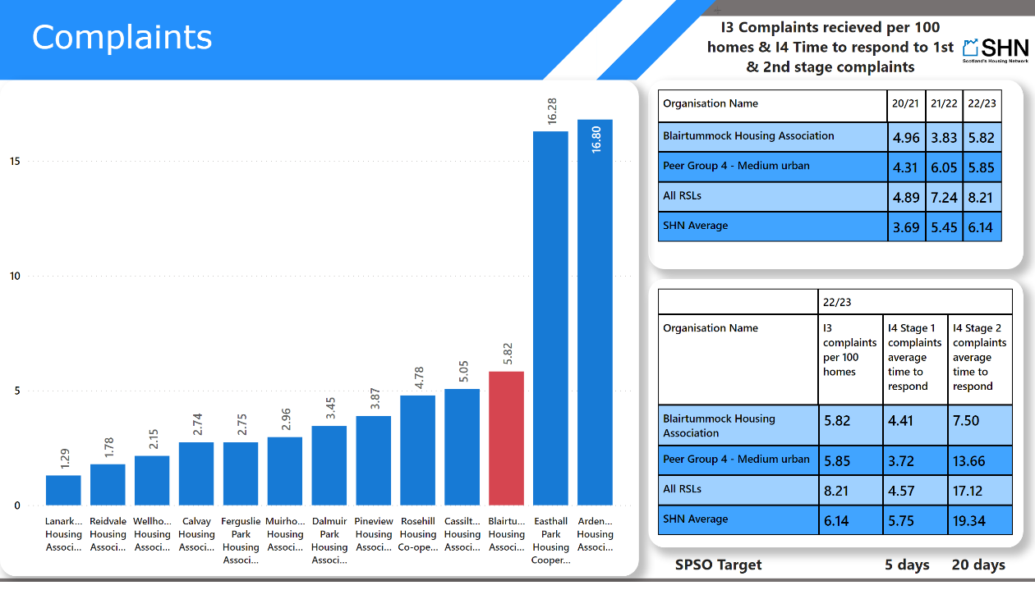
I3 & I4
Notes:
Complaints
No alt text provided
clusteredColumnChart
No alt text provided
I3 Complaints recieved per 100 homes & I4 Time to respond to 1st & 2nd stage complaints
No alt text provided
SPSO Target
No alt text provided
5 days
No alt text provided
20 days
No alt text provided
shape
No alt text provided
image
No alt text provided
image
No alt text provided
pivotTable
No alt text provided
pivotTable
No alt text provided

Slide 26
I15 per 100 homes
Notes:
Anti-Social Behaviour
No alt text provided
clusteredColumnChart
No alt text provided
I15 ASB cases per 100 homes
No alt text provided
pivotTable
No alt text provided
shape
No alt text provided
image
No alt text provided
image
No alt text provided
I15 Percentage of anti-social behaviour cases resolved
No alt text provided

Slide 27
I15 cases resolved
Notes:
Anti-Social Behaviour
No alt text provided
clusteredColumnChart
No alt text provided
I15 Percentage of anti-social behaviour cases which were resolved
No alt text provided
pivotTable
No alt text provided
shape
No alt text provided
image
No alt text provided
image
No alt text provided
I15 Percentage of anti-social behaviour cases resolved
No alt text provided

Slide 28
N31
Notes:
hundredPercentStackedColumnChart
No alt text provided
Percentage of ASB cases closed within 1 month
No alt text provided
Total number of ASB cases closed
No alt text provided
N31 Anti-social behaviour cases resolved - timescale
No alt text provided
shape
No alt text provided
image
No alt text provided
image
No alt text provided
Anti-Social Behaviour
No alt text provided

Slide 29
N32
Notes:
hundredPercentStackedColumnChart
No alt text provided
shape
No alt text provided
image
No alt text provided
image
No alt text provided
N32 Measures to resolve case
No alt text provided
Anti-Social Behaviour
No alt text provided

Slide 30
Cover 3
Notes:
Housing Quality & Maintenance
No alt text provided
image
No alt text provided
shape
No alt text provided
image
No alt text provided

Slide 31
I6
Notes:
SHQS
No alt text provided
columnChart
No alt text provided
pivotTable
No alt text provided
I6 Percentage properties meeting SHQS year end
No alt text provided
shape
No alt text provided
image
No alt text provided
image
No alt text provided
lineChart
No alt text provided

Slide 32
C10
Notes:
EESSH
No alt text provided
columnChart
No alt text provided
pivotTable
No alt text provided
C10.7 Self-contained properties that meet EESSH - Total
No alt text provided
shape
No alt text provided
image
No alt text provided
image
No alt text provided
lineChart
No alt text provided

Slide 33
I8
Notes:
Emergency Repairs
No alt text provided
clusteredColumnChart
No alt text provided
I8 Average hours to complete emergency repairs
No alt text provided
pivotTable
No alt text provided
shape
No alt text provided
image
No alt text provided
image
No alt text provided
lineChart
No alt text provided

Slide 34
I9
Notes:
Non-Emergency Repairs
No alt text provided
clusteredColumnChart
No alt text provided
I9 Average working days to complete non-emergency repairs
No alt text provided
pivotTable
No alt text provided
shape
No alt text provided
image
No alt text provided
image
No alt text provided
lineChart
No alt text provided

Slide 35
I10
Notes:
Repairs Right First Time
No alt text provided
clusteredColumnChart
No alt text provided
I10 Percentage reactive repairs completed right first time
No alt text provided
pivotTable
No alt text provided
shape
No alt text provided
image
No alt text provided
image
No alt text provided
lineChart
No alt text provided

Slide 36
I12
Notes:
Repairs Satisfaction
No alt text provided
clusteredColumnChart
No alt text provided
I12 Percentage tenants satisfied with repairs service
No alt text provided
pivotTable
No alt text provided
shape
No alt text provided
image
No alt text provided
image
No alt text provided
lineChart
No alt text provided

Slide 37
I12
Notes:
Repairs Satisfaction
No alt text provided
I12 Percentage tenants satisfied with repairs service
No alt text provided
Change from previous survey
No alt text provided
shape
No alt text provided
image
No alt text provided
image
No alt text provided
shape
No alt text provided
image
No alt text provided
image
No alt text provided

Slide 38
I11
Notes:
Gas Safety
No alt text provided
clusteredColumnChart
No alt text provided
pivotTable
No alt text provided
I11 Gas safety fails count
No alt text provided
shape
No alt text provided
image
No alt text provided
image
No alt text provided
lineChart
No alt text provided

Slide 39
I11
Notes:
Gas Safety
No alt text provided
I11 Gas safety regulations not met
No alt text provided
Change from previous survey
No alt text provided
shape
No alt text provided
image
No alt text provided
image
No alt text provided
image
No alt text provided
shape
No alt text provided

Slide 40
Cover 4
Notes:
Access to Housing
No alt text provided
image
No alt text provided
shape
No alt text provided
image
No alt text provided

Slide 41
Housing Lists & Lets
Notes:
Access to Housing
No alt text provided
pivotTable
No alt text provided
shape
No alt text provided
image
No alt text provided
image
No alt text provided

Slide 42
I17
Notes:
Turnover
No alt text provided
clusteredColumnChart
No alt text provided
I17 Percentage lettable self-contained houses that became vacant in year
No alt text provided
pivotTable
No alt text provided
shape
No alt text provided
image
No alt text provided
image
No alt text provided
lineChart
No alt text provided

Slide 43
I14
Notes:
Offers Refused
No alt text provided
clusteredColumnChart
No alt text provided
I14 Percentage tenancy offers refused
No alt text provided
pivotTable
No alt text provided
shape
No alt text provided
image
No alt text provided
image
No alt text provided
lineChart
No alt text provided

Slide 44
C2
Notes:
Lets by Source
No alt text provided
hundredPercentStackedColumnChart
No alt text provided
pivotTable
No alt text provided
C2 percentage of lets by source of let
No alt text provided
shape
No alt text provided
image
No alt text provided
image
No alt text provided

Slide 45
C2 - Excluding Homeless
Notes:
Lets by Source (Excluding Lets to Homeless Households)
No alt text provided
columnChart
No alt text provided
pivotTable
No alt text provided
C2 percentage of lets by source of let
No alt text provided
shape
No alt text provided
image
No alt text provided
image
No alt text provided

Slide 46
C2 - Homeless
Notes:
Lets to Homeless Households
No alt text provided
clusteredColumnChart
No alt text provided
C2 Percentage of lets to homeless applicants
No alt text provided
pivotTable
No alt text provided
shape
No alt text provided
image
No alt text provided
image
No alt text provided
lineChart
No alt text provided

Slide 47
I16
Notes:
Tenancy Sustainment
No alt text provided
clusteredColumnChart
No alt text provided
pivotTable
No alt text provided
I16 Percentage tenancies began in previous year remained more than a year - all
No alt text provided
Number of tenancies began in previous year remained more than a year - all
No alt text provided
shape
No alt text provided
image
No alt text provided
image
No alt text provided
lineChart
No alt text provided

Slide 48
I16
Notes:
Tenancy Sustainment
No alt text provided
clusteredColumnChart
No alt text provided
pivotTable
No alt text provided
I16 Percentage tenancies began in previous year remained more than a year - all
No alt text provided
shape
No alt text provided
image
No alt text provided
image
No alt text provided
lineChart
No alt text provided

Slide 49
I16 - Homeless
Notes:
Tenancy Sustainment (Homeless)
No alt text provided
clusteredColumnChart
No alt text provided
I16 Percentage tenancies began in previous year remained more than a year - applicants assessed statutory homeless LA
No alt text provided
pivotTable
No alt text provided
shape
No alt text provided
image
No alt text provided
image
No alt text provided
lineChart
No alt text provided

Slide 50
N10
Notes:
Tenancy Terminations
No alt text provided
hundredPercentStackedColumnChart
No alt text provided
pivotTable
No alt text provided
shape
No alt text provided
image
No alt text provided
image
No alt text provided
N10 Tenancy Sustainment - Terminations within 12 months
No alt text provided

Slide 51
C4 & I22
Notes:
Abandonments and Evictions
No alt text provided
columnChart
No alt text provided
pivotTable
No alt text provided
C4 Abandonments & and I22 evictions as a percentage of stock
No alt text provided
shape
No alt text provided
image
No alt text provided
image
No alt text provided

Slide 52
I21
Notes:
Medical Adaptations
No alt text provided
clusteredColumnChart
No alt text provided
I21 Average days to complete approved adaptations
No alt text provided
pivotTable
No alt text provided
shape
No alt text provided
image
No alt text provided
image
No alt text provided
lineChart
No alt text provided

Slide 53
I19
Notes:
Medical Adaptations
No alt text provided
clusteredColumnChart
No alt text provided
I19 Percentage approved applications for medical adaptations completed
No alt text provided
pivotTable
No alt text provided
shape
No alt text provided
image
No alt text provided
image
No alt text provided
lineChart
No alt text provided

Slide 54
I21
Notes:
Medical Adaptations
No alt text provided
scatterChart
No alt text provided
pivotTable
No alt text provided
I21 Average cost of adaptation
No alt text provided
vs
No alt text provided
I21 Average days to complete approved adaptations
No alt text provided
shape
No alt text provided
image
No alt text provided
image
No alt text provided

Slide 55
Cover 5
Notes:
Homelessness
No alt text provided
image
No alt text provided
shape
No alt text provided
image
No alt text provided

Slide 56
H1
Notes:
Homeless Applicants
No alt text provided
clusteredColumnChart
No alt text provided
lineChart
No alt text provided
pivotTable
No alt text provided
H1 Applications per 1,000 people
No alt text provided
shape
No alt text provided
image
No alt text provided

Slide 57
H5
Notes:
Days to Assess Application
No alt text provided
clusteredColumnChart
No alt text provided
lineChart
No alt text provided
pivotTable
No alt text provided
H5 Average days to assess application
No alt text provided
shape
No alt text provided
image
No alt text provided
image
No alt text provided

Slide 58
H7
Notes:
Weeks to Close Case
No alt text provided
clusteredColumnChart
No alt text provided
lineChart
No alt text provided
pivotTable
No alt text provided
H7 Average number of weeks to complete case
No alt text provided
shape
No alt text provided
image
No alt text provided
image
No alt text provided

Slide 59
H3 Social Tenancy Outcomes
Notes:
Social Tenancy Outcomes
No alt text provided
columnChart
No alt text provided
pivotTable
No alt text provided
H3 Outcomes unintentional LA tenancy & RSL
No alt text provided
shape
No alt text provided
image
No alt text provided
image
No alt text provided

Slide 60
H17
Notes:
Live Cases
No alt text provided
clusteredColumnChart
No alt text provided
pivotTable
No alt text provided
All live cases
No alt text provided
lineChart
No alt text provided
shape
No alt text provided
image
No alt text provided
image
No alt text provided

Slide 61
H15
Notes:
Length of Stay in TA
No alt text provided
clusteredColumnChart
No alt text provided
lineChart
No alt text provided
pivotTable
No alt text provided
H15 Average duration in temporary accommodation for entire placement All household types
No alt text provided
shape
No alt text provided
image
No alt text provided
image
No alt text provided

Slide 62
Cover 6
Notes:
Rents
No alt text provided
image
No alt text provided
shape
No alt text provided
image
No alt text provided

Slide 63
C17
Notes:
Rents
No alt text provided
clusteredColumnChart
No alt text provided
C17 Lettable self-contained units - Total - Average weekly rent
No alt text provided
pivotTable
No alt text provided
shape
No alt text provided
image
No alt text provided
image
No alt text provided
lineChart
No alt text provided

Slide 64
C5
Notes:
Rents
No alt text provided
clusteredColumnChart
No alt text provided
C5 Percentage average weekly rent increase to be applied next year
No alt text provided
pivotTable
No alt text provided
shape
No alt text provided
image
No alt text provided
image
No alt text provided
lineChart
No alt text provided

Slide 65
C5 & C17
Notes:
Rents
No alt text provided
clusteredColumnChart
No alt text provided
pivotTable
No alt text provided
C5 Percentage average weekly rent increase to be applied next year & C17 Average weekly rent
No alt text provided
pivotTable
No alt text provided
shape
No alt text provided
image
No alt text provided
image
No alt text provided

Slide 66
N18
Notes:
clusteredColumnChart
No alt text provided
lineChart
No alt text provided
pivotTable
No alt text provided
N18 Rent consultation response rate
No alt text provided
shape
No alt text provided
image
No alt text provided
image
No alt text provided
Rent Consultation
No alt text provided

Slide 67
I26
Notes:
Rent Collection
No alt text provided
clusteredColumnChart
No alt text provided
I26 Percentage collected of rent due
No alt text provided
pivotTable
No alt text provided
shape
No alt text provided
image
No alt text provided
image
No alt text provided
lineChart
No alt text provided

Slide 68
I27 - Current
Notes:
Arrears
No alt text provided
I27 Current arrears percentage of rent due
No alt text provided
clusteredColumnChart
No alt text provided
pivotTable
No alt text provided
shape
No alt text provided
image
No alt text provided
image
No alt text provided
lineChart
No alt text provided

Slide 69
I27 - Former
Notes:
Arrears
No alt text provided
I27 Former arrears percentage of rent due
No alt text provided
clusteredColumnChart
No alt text provided
pivotTable
No alt text provided
shape
No alt text provided
image
No alt text provided
image
No alt text provided
lineChart
No alt text provided

Slide 70
N34 - Terminating
Notes:
clusteredColumnChart
No alt text provided
lineChart
No alt text provided
pivotTable
No alt text provided
N34 Percentage of tenants terminating tenancy with arrears
No alt text provided
shape
No alt text provided
image
No alt text provided
image
No alt text provided
Terminating with Arrears
No alt text provided

Slide 71
N34 - Average Debt
Notes:
clusteredColumnChart
No alt text provided
lineChart
No alt text provided
pivotTable
No alt text provided
N34 Average debt owed when leaving
No alt text provided
shape
No alt text provided
image
No alt text provided
image
No alt text provided
Terminating with Arrears
No alt text provided

Slide 72
N35 - Arrears Collected
Notes:
clusteredColumnChart
No alt text provided
N35 Percentage of former tenant arrears collected as percentage of FTA's at year end
No alt text provided
N35 Percentage of former tenant arrears collected as percentage of FTA's at year end
No alt text provided
N35 Percentage of former tenant arrears collected as a percentage of FTA's at year end
No alt text provided
shape
No alt text provided
image
No alt text provided
image
No alt text provided
Former Tenant Arrears Collected
No alt text provided

Slide 73
C7
Notes:
Arrears Written Off
No alt text provided
clusteredColumnChart
No alt text provided
C7 Percentage former tenant rent arrears written off
No alt text provided
pivotTable
No alt text provided
shape
No alt text provided
image
No alt text provided
image
No alt text provided
lineChart
No alt text provided

Slide 74
I27 - Gross
Notes:
Arrears
No alt text provided
columnChart
No alt text provided
pivotTable
No alt text provided
I27 Percentage gross rent arrears of rent due
No alt text provided
shape
No alt text provided
image
No alt text provided
image
No alt text provided
lineChart
No alt text provided

Slide 75
I27 - Gross
Notes:
Arrears (Trends)
No alt text provided
lineChart
No alt text provided
pivotTable
No alt text provided
I27 Percentage gross rent arrears of rent due
No alt text provided
shape
No alt text provided
image
No alt text provided
image
No alt text provided

Slide 76
I27 - Gross
Notes:
Arrears (Trends)
No alt text provided
clusteredColumnChart
No alt text provided
pivotTable
No alt text provided
I27 Percentage gross rent arrears of rent due
No alt text provided
shape
No alt text provided
image
No alt text provided
image
No alt text provided

Slide 77
N33
Notes:
Tenancy Arrears
No alt text provided
lineChart
No alt text provided
pivotTable
No alt text provided
N33 Percentage of tenancies in arrears at year end
No alt text provided
columnChart
No alt text provided
shape
No alt text provided
image
No alt text provided
image
No alt text provided

Slide 78
Cover 7
Notes:
Voids
No alt text provided
shape
No alt text provided
image
No alt text provided
shape
No alt text provided
image
No alt text provided

Slide 79
I30
Notes:
Relet Times
No alt text provided
clusteredColumnChart
No alt text provided
I30 Average time to re-let properties
No alt text provided
pivotTable
No alt text provided
shape
No alt text provided
image
No alt text provided
image
No alt text provided
lineChart
No alt text provided

Slide 80
N36 - Low Demand
Notes:
clusteredColumnChart
No alt text provided
lineChart
No alt text provided
pivotTable
No alt text provided
N36 Percentage of lets that are low demand
No alt text provided
shape
No alt text provided
image
No alt text provided
image
No alt text provided
Lets
No alt text provided

Slide 81
N36 - Not Low Demand Relet Time
Notes:
clusteredColumnChart
No alt text provided
lineChart
No alt text provided
pivotTable
No alt text provided
N36 Not Low Demand relets average relet time
No alt text provided
shape
No alt text provided
image
No alt text provided
image
No alt text provided
Lets
No alt text provided

Slide 82
N36 - Low Demand Relet Time
Notes:
clusteredColumnChart
No alt text provided
lineChart
No alt text provided
pivotTable
No alt text provided
N36 Low Demand relets average relet time
No alt text provided
shape
No alt text provided
image
No alt text provided
image
No alt text provided
Lets
No alt text provided

Slide 83
N36 - Low & Not Low Demand Relet Time
Notes:
clusteredColumnChart
No alt text provided
pivotTable
No alt text provided
N36 - Low Demand & Not Low Demand Average Relet Time
No alt text provided
shape
No alt text provided
image
No alt text provided
image
No alt text provided
Lets
No alt text provided

Slide 84
N43
Notes:
Standard of Home when Moving In
No alt text provided
clusteredColumnChart
No alt text provided
lineChart
No alt text provided
pivotTable
No alt text provided
N43 Percentage satisfied with standard of home when moving in
No alt text provided
shape
No alt text provided
image
No alt text provided
image
No alt text provided

Slide 85
I18
Notes:
Void Rent Loss
No alt text provided
clusteredColumnChart
No alt text provided
I18 Percentage of rent due lost through properties being empty
No alt text provided
pivotTable
No alt text provided
shape
No alt text provided
image
No alt text provided
image
No alt text provided
lineChart
No alt text provided

Slide 86
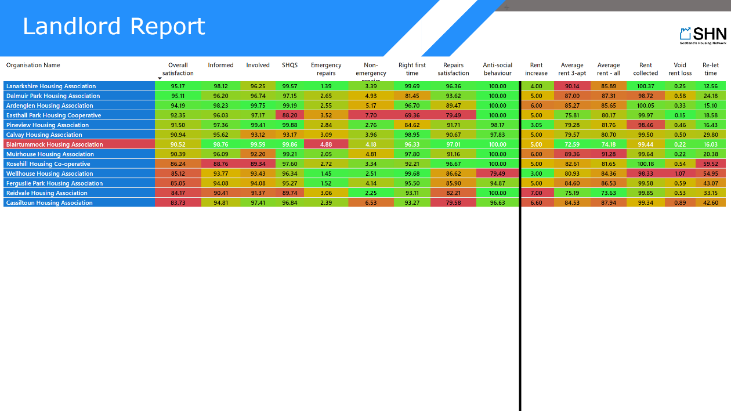
Landlord Report
Notes:
Landlord Report
No alt text provided
tableEx
No alt text provided
shape
No alt text provided
shape
No alt text provided
image
No alt text provided
image
No alt text provided

Slide 87
Landlord Report
Notes:
Landlord Report
No alt text provided
Service vs Value for money
No alt text provided
card
No alt text provided
90
No alt text provided
70
No alt text provided
50
No alt text provided
30
No alt text provided
10
No alt text provided
10
No alt text provided
30
No alt text provided
50
No alt text provided
70
No alt text provided
90
No alt text provided
shape
No alt text provided
shape
No alt text provided
shape
No alt text provided
shape
No alt text provided
shape
No alt text provided
shape
No alt text provided
shape
No alt text provided
shape
No alt text provided
shape
No alt text provided
shape
No alt text provided
card
No alt text provided
scatterChart
No alt text provided
shape
No alt text provided
image
No alt text provided
image
No alt text provided

Slide 88
Communities of Practice
Notes:
Communities of Practice
No alt text provided
Tenants Surveyed:
No alt text provided
Tenants Surveyed:
No alt text provided
shape
No alt text provided
shape
No alt text provided
shape
No alt text provided
shape
No alt text provided
shape
No alt text provided
shape
No alt text provided
shape
No alt text provided
shape
No alt text provided
shape
No alt text provided
shape
No alt text provided
shape
No alt text provided
shape
No alt text provided
shape
No alt text provided
image
No alt text provided
shape
No alt text provided
image
No alt text provided
image
No alt text provided

Slide 89
Membership Offer
Notes:
Membership Offer
No alt text provided
Tenants Surveyed:
No alt text provided
shape
No alt text provided
shape
No alt text provided
shape
No alt text provided
shape
No alt text provided
shape
No alt text provided
shape
No alt text provided
image
No alt text provided
shape
No alt text provided
shape
No alt text provided
shape
No alt text provided
shape
No alt text provided
shape
No alt text provided
image
No alt text provided
image
No alt text provided

Slide 90
Contact Us
Notes:
Contact Us
No alt text provided
image
No alt text provided
image
No alt text provided
image
No alt text provided
Tenants Surveyed:
No alt text provided
shape
No alt text provided
image
No alt text provided
shape
No alt text provided
image
No alt text provided
image
No alt text provided

